Slide 1
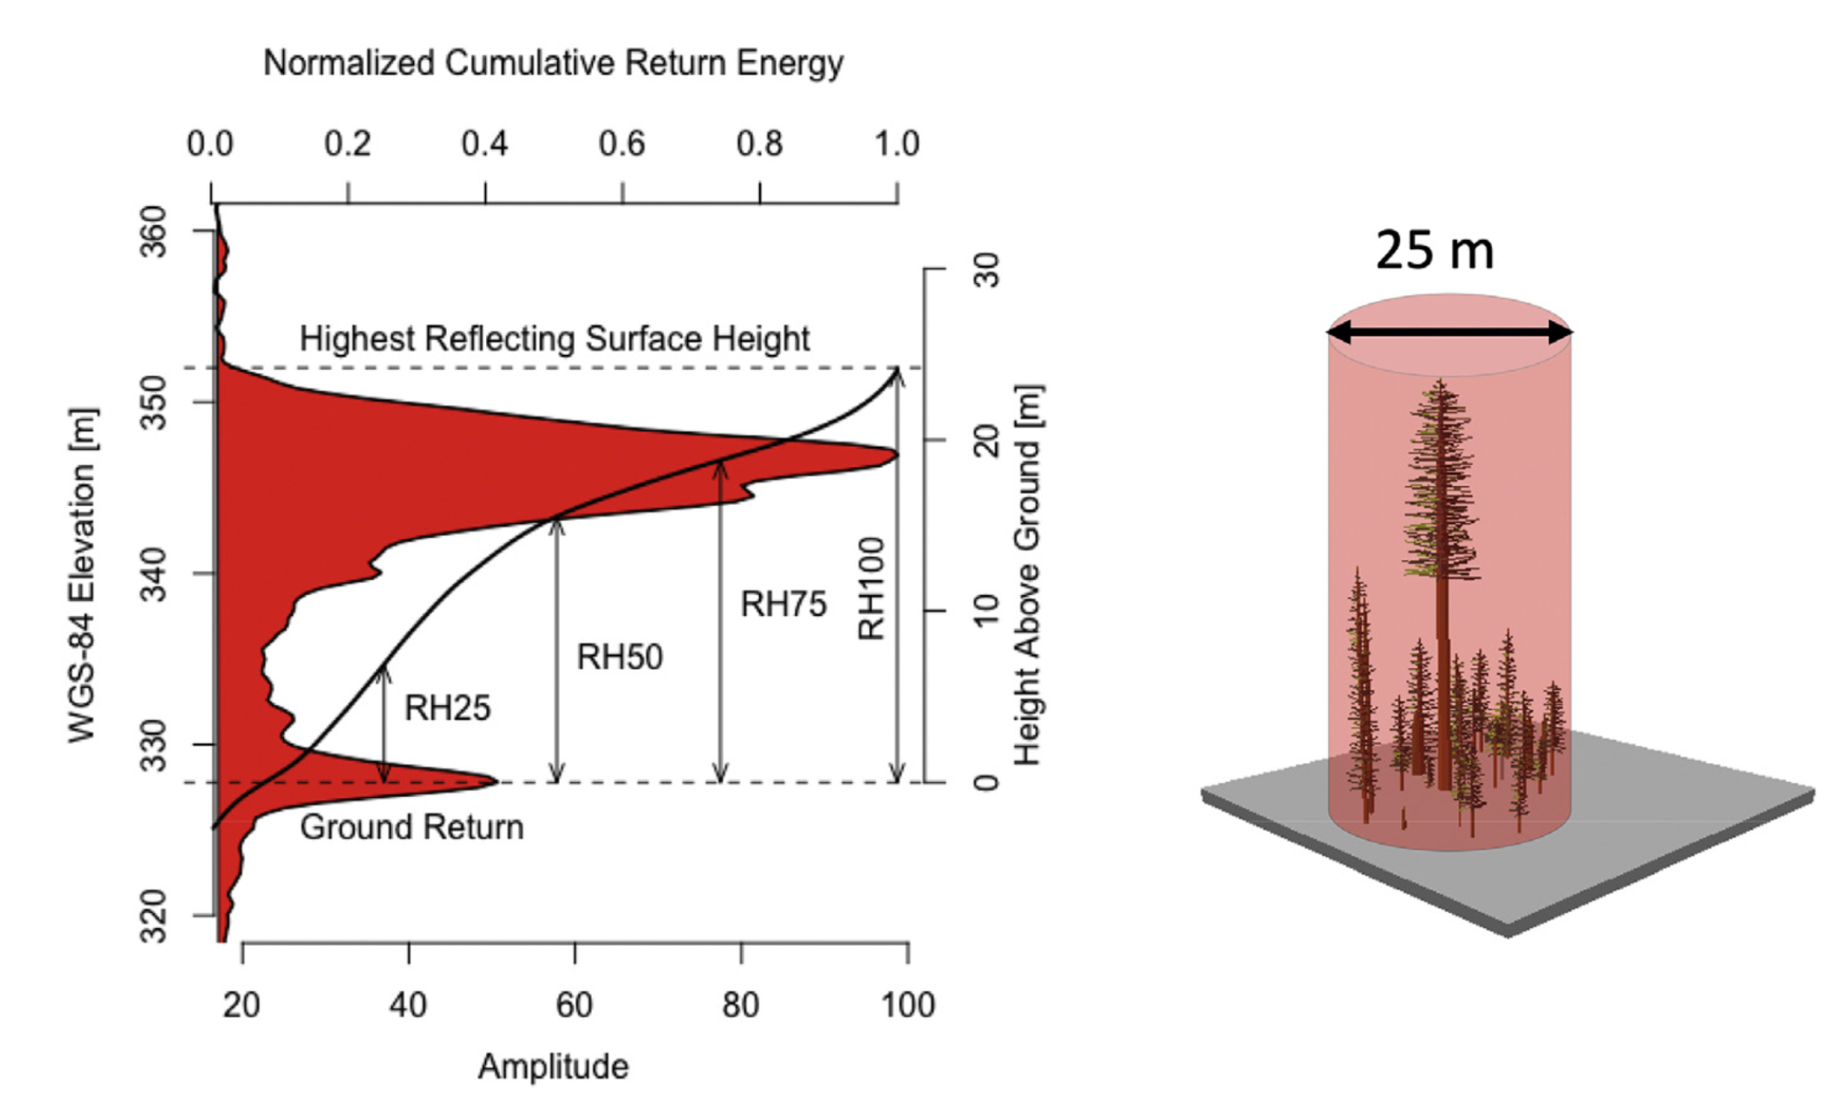
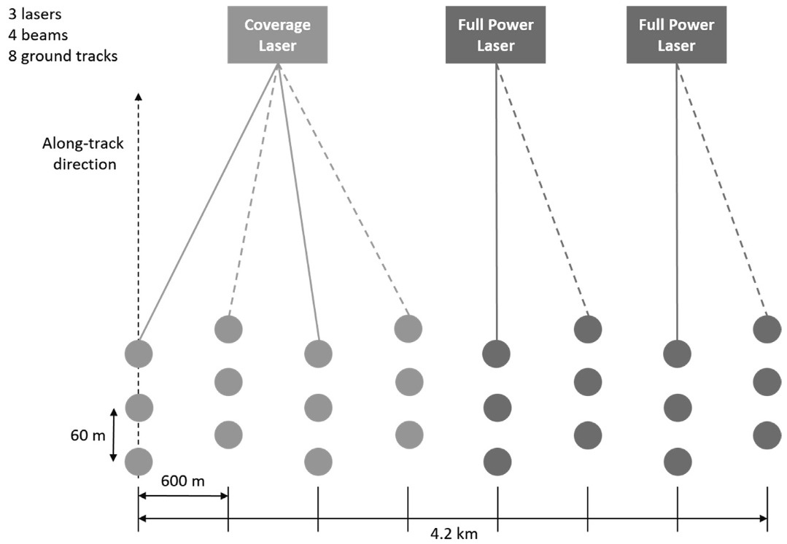
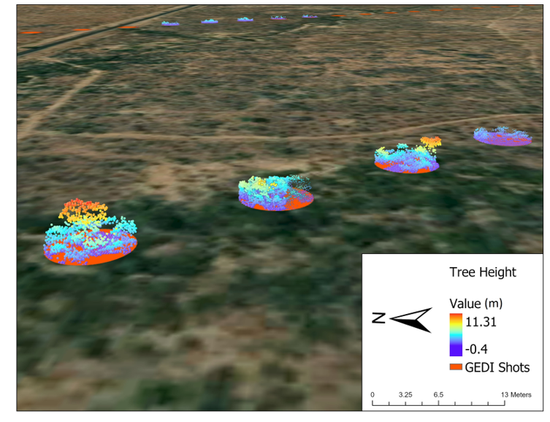
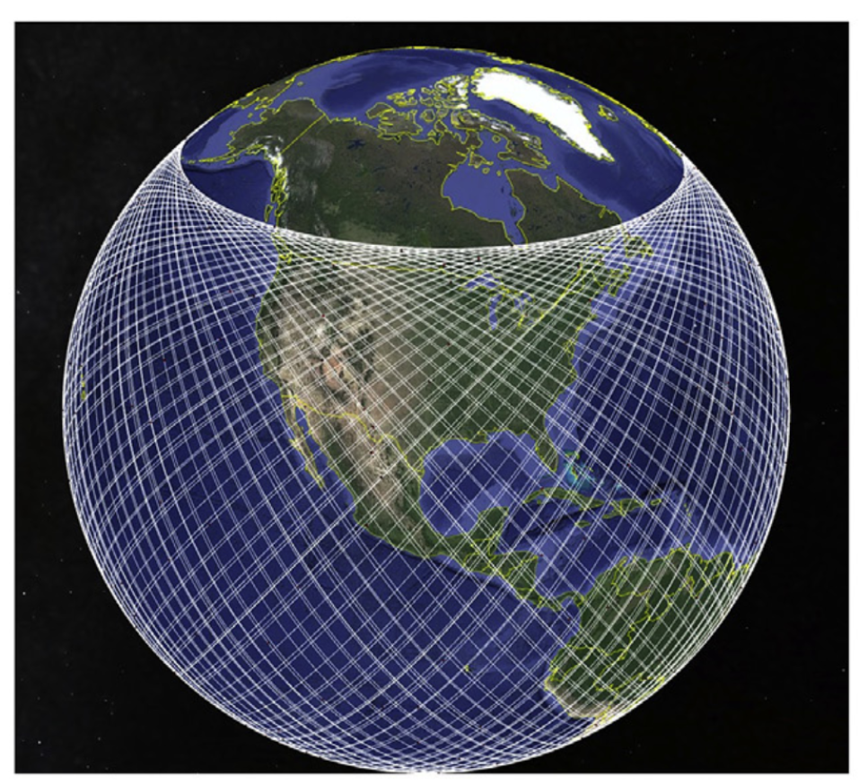

NASA’s Global Ecosystem Dynamic Investigation
(GEDI)
Dubayah et al., 2020
GEDI produces the first high resolution laser ranging observations of the 3D structure of the Earth.
GEDI instrument design, algorithm calibration and validation were focused on the measurement of tall, dense tropical and temperate & tropical forests, not savannas.
600 m
60 m
25 m
Notes:
https://www.youtube.com/watch?v=xsoMcw4upjs

Slide 2
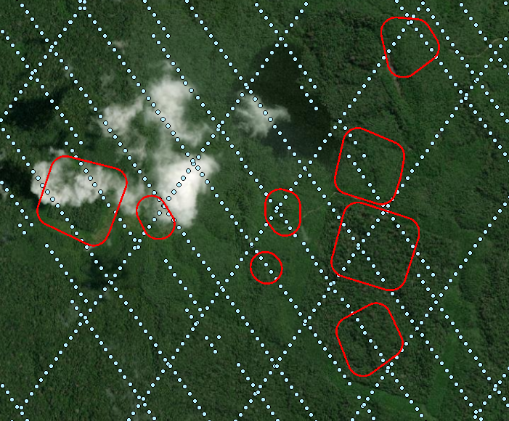
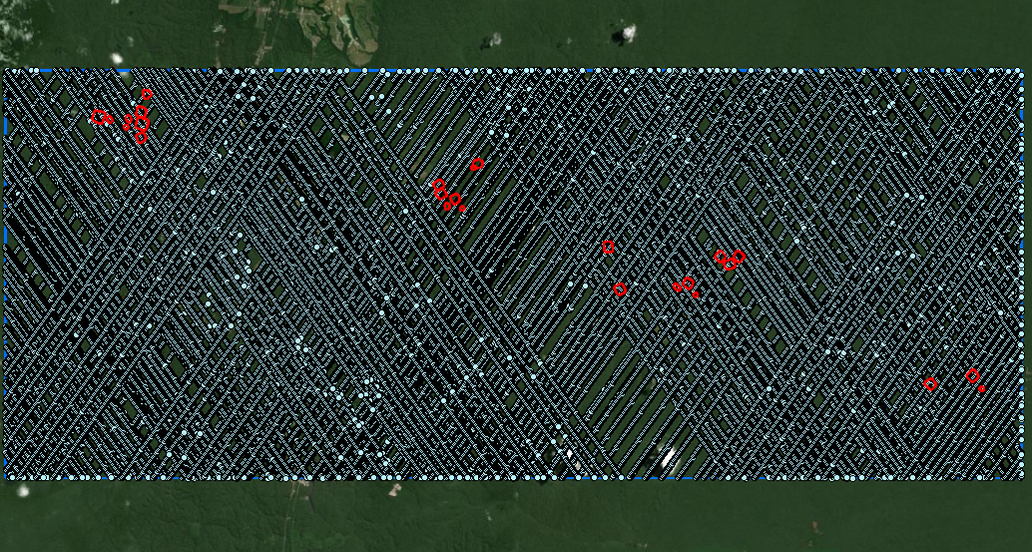
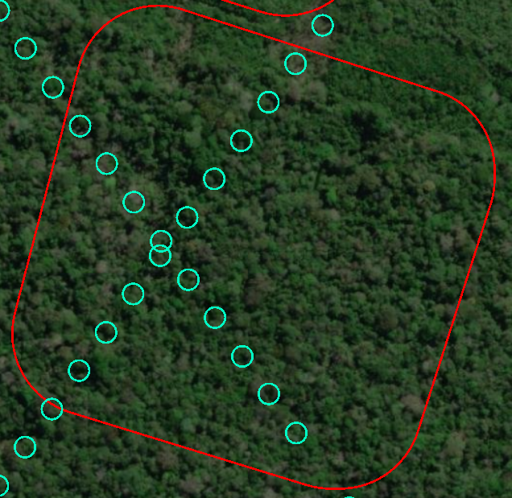
GEDI over BDFFP biodiversity sites
GEDI sample size: ~47,000

Slide 3
GEDI data specification
Data availability: Apr 2019- Jan 2023
Spatial coverage: 51.6 degree N & S
Data format: HDF5 (Hierarchical Data Format version 5)
Download: https://search.earthdata.nasa.gov/search?q=GEDI
GEDI datasets:
GEDI L1B - Geolocated Waveforms: Full waveform lidar return data, georeferenced at each footprint
GEDI L2A - Canopy Height & Ground Elevation: Metrics such as canopy top height, ground elevation, and waveform-derived parameters
GEDI L2B - Canopy Cover & Foliage Profile: Estimates of canopy cover and leaf area index (LAI)
GEDI L4A - Aboveground Biomass Density (AGBD): Estimates of aboveground biomass per footprint
GEDI L4B - Gridded AGBD: Biomass estimates in raster format at different spatial resolutions

Slide 4
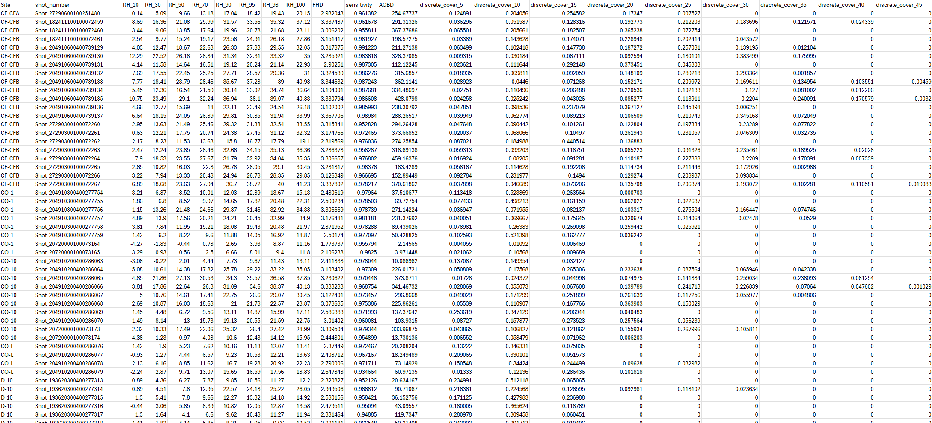
GEDI table

Slide 5
GEDI variables (selected)
Variable group | Variables | Description
Site and biodiversity | Site, AA, SR, etc. | All biodiversity data and corresponding study locations
GEDI (ancillary) | GEDI footprint count, sensitivity, quality flags | The number of GEDI footprints within each biodiversity site, GEDI beam sensitivity for information only, quality flags (q2a, q2b, q4a)
GEDI L2A RHs | GEDI RH10, 30, 50, 70, 90, 95, 98, 100 | A group of GEDI Relative Height metrics.
GEDI L4A | GEDI AGBD | The standard footprint-level GEDI AGBD product.
GEDI L2B (total) | Total cover, total pai, total pavd | The aggregated values of GEDI total cover (cover_total_mean, cover_total_std), total pai (pai_total_mean, pai_total_std), and total pavd (pavd_total_mean, pavd_total_std).
GEDI L2B (discrete) | Discrete cover, pai, and pavd at 5m intervals | Aggregated values of non-accumulative, discrete cover, pai, and pavd metrics, computed for intervals (e.g., cover_10_mean and cover_10_std represent canopy cover mean and std within 5–10m height bin).
GEDI L2B (Ratio and maximum height bins count) | Ratio of discrete cover, pai, and pavd; height bins count for maximum values | The ratio of discrete cover, pai, and pavd values and counts of height bins corresponding to the maximum canopy cover, pai, or pavd. For instance, cover_15_count indicates the number of GEDI footprints with the highest canopy cover in the 5–10m range.
Note: make sure quality flags = 1 to filter out bad quality data.

Slide 6
Resources
GEDI ATBDs, user guide, data dictionary.
Google folder link: https://drive.google.com/drive/folders/19GHMiaqUTl-lrOSSVgTFtprwAM-_0WBO?usp=sharing
Data download and processing: https://github.com/Shawn4889/GEDI-biodiversity/tree/main
GEDI_download.R: download GEDI files.
Basic_GEDI_Luther.py: derive GEDI L2A and L2B metrics from GEDI HDF5 raw files.
Basic_GEDI_biom_Luther.py: derive GEDI L4A biomass estimates from GEDI HDF5 raw files.
Luther_ratio.py: calculate local maxima, ratio, and more from GEDI L2B metrics.

